Slide 1



Team Envision Presentation II
‘Tune into your tastes'

Slide 2




Contents
Our Albums
Objectives
Key Questions
Data Overview
Contents
Data Pipeline
Dataset #1
Next Steps
Dataset #2
Challenges
Dataset #3
To be continued...
Notes:
Kim

Slide 3



Our Album of APIs
Contents
Our Albums
Objectives
Key Questions
Data Overview
Spotify API
billboard API
Data Pipeline
Dataset #1
Dataset #2
Dataset #3
last.fm API
Notes:
Kim

Slide 4

Our Objectives
Contents
Our Inspiration: Understand trends in musician’s creation of music and audience’s listening habits across various dimensions
What audio features are most popular and where?
How have audio trends evolved over time?
Develop a ML-based model to recommend songs based on the listener’s preferences, audio features and geographical specificities
Our Albums
Objectives
Main Objectives
Key Questions
Data Overview
Data Pipeline
Extra Ambition
Dataset #1
Dataset #2
Dataset #3
4
Notes:
Sasha

Slide 5
Key Questions
How has the popularity of artists changed over the last three years? (Billboard & Spotify API)
How do follower count, top tracks and number of streams translate to an artist’s popularity index?
What is the geographic distribution of popular audio features? (Spotify API)
How do the audio features of particular artists change over time? (Spotify & Last.FM APIs)
Of the top 500 Artists, how significant is variation between their number of listeners and their number of plays? (Spotify & Last.FM APIs)
Contents
Our Albums
Objectives
Key Questions
Data Overview
Data Pipeline
Dataset #1
Dataset #2
Dataset #3
5

Slide 6

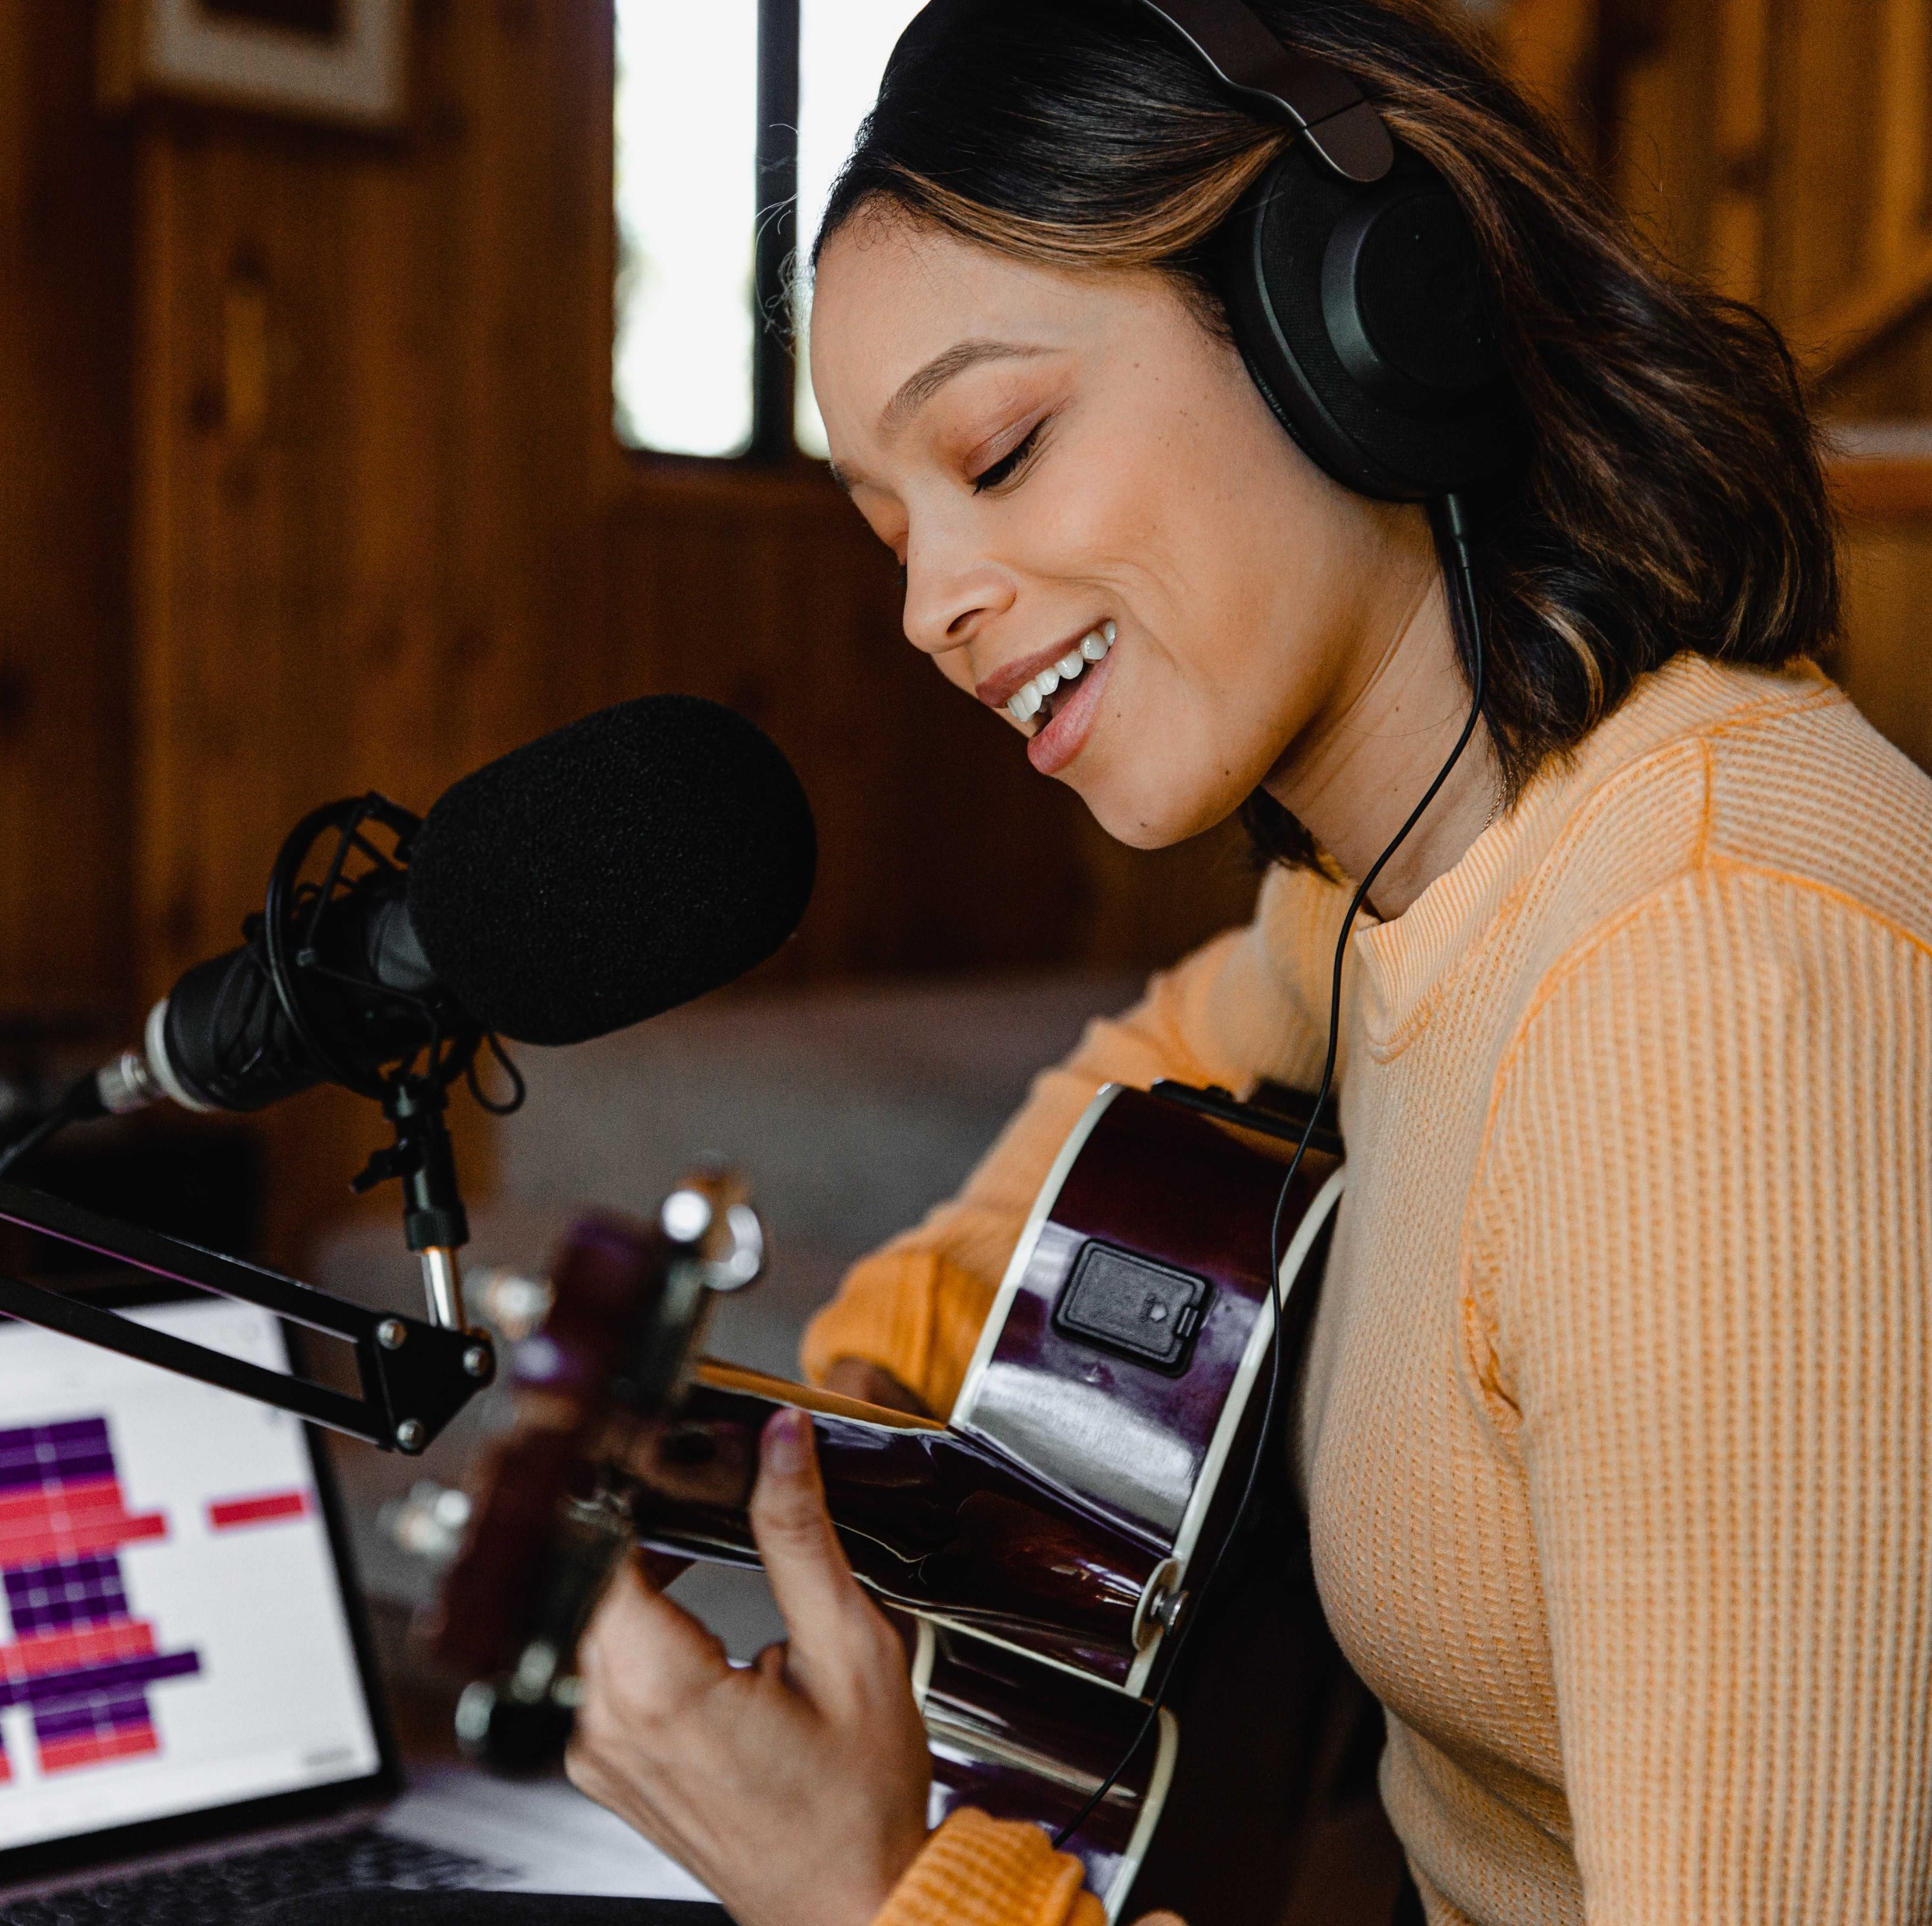

Spotify & last.fm (Dataset #1):
Spotify (Dataset #2): A list of 72 dictionaries:
Keys ‘country’ and ‘playlist_url’. Each url links to a playlist showing the Top 50 most listened to songs in that country (updated daily)
Rationale: To find out what kind of music is most popular as of right now in each country
Spotify & Billboard (Dataset #3): List of Top 20 artists ranked by popularity index
Explore how artists and their top tracks' popularity correlate and what makes an artist popular
Data Overview
Contents
Our Albums
Objectives
Key Questions
Data Overview
Data Pipeline
Dataset #1
Dataset #2
Dataset #3
Notes:
Jacen

Slide 7

Data Pipeline
Contents
Our Albums
Capture
Spotify API – main
Deezer API
Process and Analyse
Data Wrangling
Data Cleaning
Visualise
Pandas Dataframe
Plotnine and Matplotlib
Billboard API
Objectives
Key Questions
Data Overview
Data Pipeline
Removed outliers, bad values, converted values
DataFrame modification – merging, pivoting
Created helpful functions to ease access to data
Dataset #1
Dataset #2
Dataset #3
Notes:
Jacen

Slide 8
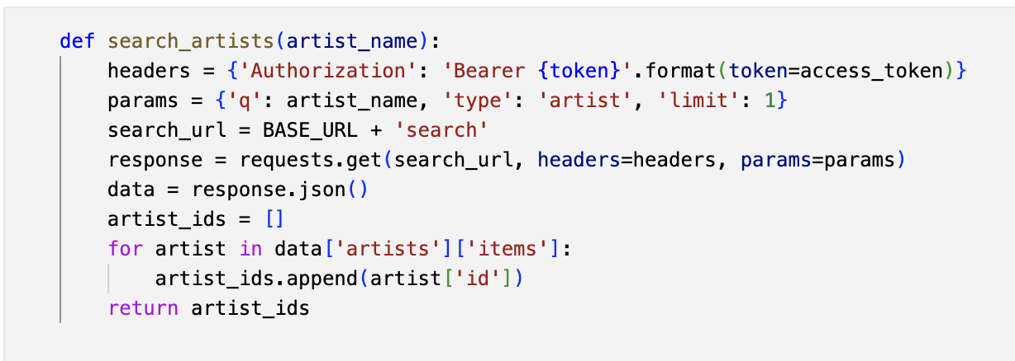
Data Wrangling (Dataset #1)
How do the audio features of particular artists change over time? (Spotify & last.fm APIs)
Contents
Our Albums
Created a function that will find an artist’s Spotify ID by entering their name as opposed to manually searching
Objectives
Key Questions
Data Overview
Data Pipeline
Dataset #1
Dataset #2
Dataset #3
8
Notes:
Audio features of all the top 50 songs of the day in a country displayed in a dataframe

Slide 9
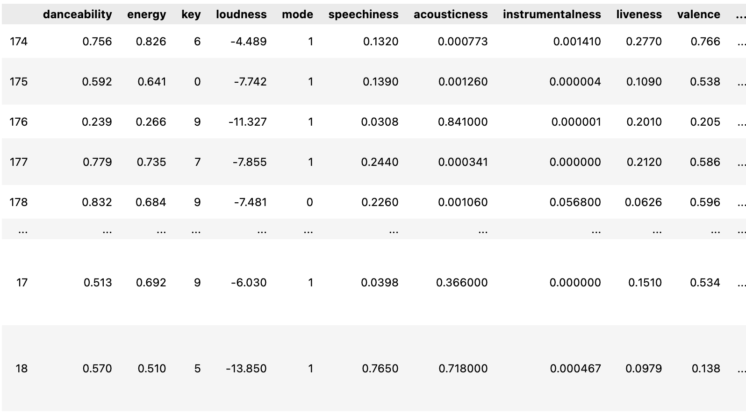
Data Processing (Dataset #1)
How do the audio features of particular artists change over time? (Spotify & last.fm APIs)
Contents
Our Albums
Created a df.Pandas to display the audio features of artists’ (e.g Rihanna) songs
Objectives
Key Questions
Data Overview
Data Pipeline
Dataset #1
Dataset #2
Dataset #3
Notes:
Audio features of all the top 50 songs of the day in a country displayed in a dataframe

Slide 10
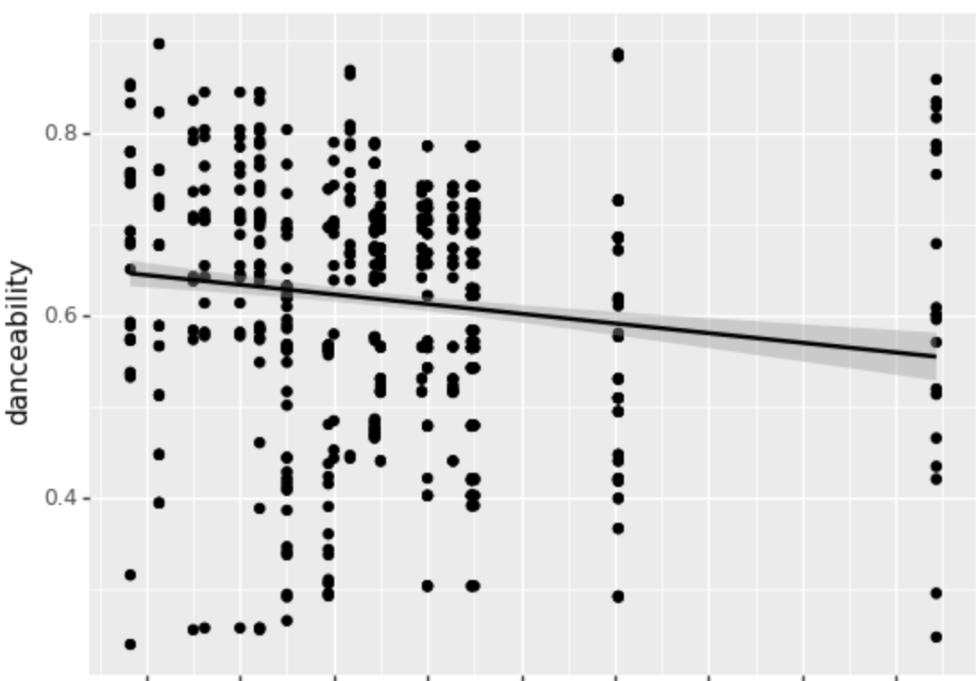
Data Visualization (Dataset #1)
How do the audio features of particular artists change over time? (Spotify & last.fm APIs)
Contents
Our Albums
Visualizing the evolution of Rihanna’s ‘Danceability” over time
Objectives
Key Questions
Data Overview
Data Pipeline
Dataset #1
Dataset #2
Dataset #3
11
Notes:
Audio features of all the top 50 songs of the day in a country displayed in a dataframe

Slide 11
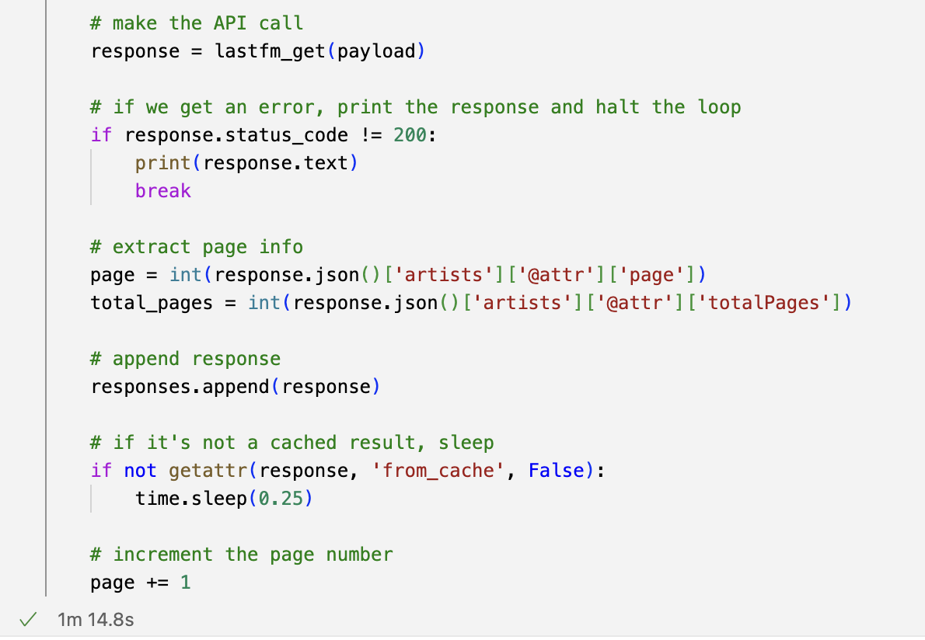
Data Wrangling (Dataset #1)
How do the audio features of particular artists change over time? (Spotify & last.fm APIs)
Contents
Our Albums
Created a cache to reduce run time from 90 minutes to < 1 minute
Objectives
Key Questions
Data Overview
Data Pipeline
Dataset #1
Dataset #2
Dataset #3
9
Notes:
Audio features of all the top 50 songs of the day in a country displayed in a dataframe

Slide 12
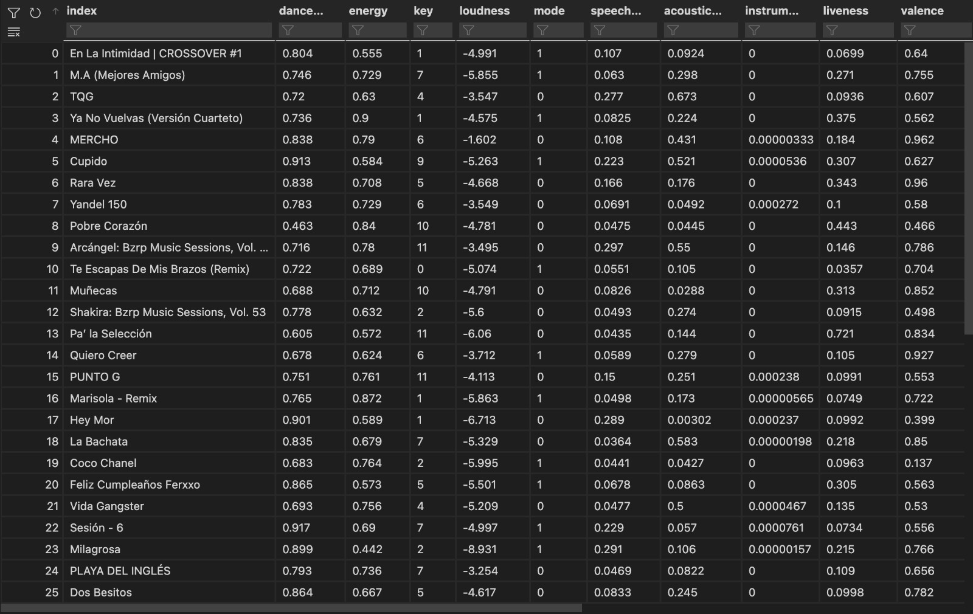
Data Wrangling (Dataset #2)
What is the geographic distribution of popular audio features? (Spotify API)
Contents
Our Albums
Audio features of Top 50 songs in a country displayed in a pandas DataFrame
Objectives
Key Questions
Data Overview
Data Pipeline
Dataset #1
Dataset #2
Dataset #3
12
Notes:
Audio features of all the top 50 songs of the day in a country displayed in a dataframe

Slide 13
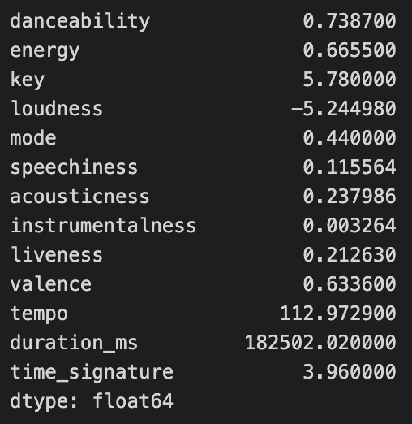
Data Processing (Dataset #2)
What is the geographic distribution of popular audio features? (Spotify API)
Contents
Using .mean() method to get mean values in one country in the form of a pandas series
Our Albums
Objectives
Key Questions
Data Overview
Data Pipeline
Dataset #1
Dataset #2
Dataset #3
13
Notes:
Audio features of all the top 50 songs of the day in a country displayed in a dataframe

Slide 14
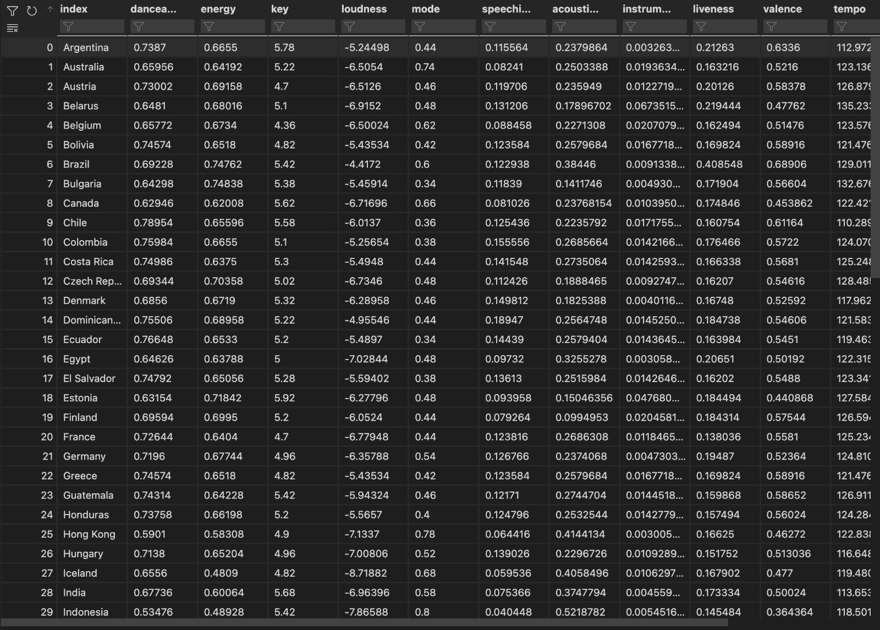

Data Processing (Dataset #2)
What is the geographic distribution of popular audio features? (Spotify API)
Contents
Converting series into a dataframe and then joining all of them into one dataframe
Our Albums
Objectives
Key Questions
Data Overview
Data Pipeline
Dataset #1
Dataset #2
Dataset #3
Notes:
Audio features of all the top 50 songs of the day in a country displayed in a dataframe

Slide 15
Data Processing (Dataset #2)
What is the geographic distribution of popular audio features? (Spotify API)
Contents
Using .mean() method to get mean values in one country in the form of a pandas series
Our Albums
Objectives
Key Questions
Data Overview
Data Pipeline
Dataset #1
Dataset #2
Dataset #3
15
Notes:
Audio features of all the top 50 songs of the day in a country displayed in a dataframe

Slide 16
Data Processing (Dataset #2)
What is the geographic distribution of popular audio features? (Spotify API)
Contents
Using .mean() method to get mean values in one country in the form of a pandas series
Our Albums
Objectives
Key Questions
Data Overview
Data Pipeline
Dataset #1
Dataset #2
Dataset #3
16
Notes:
Audio features of all the top 50 songs of the day in a country displayed in a dataframe

Slide 17
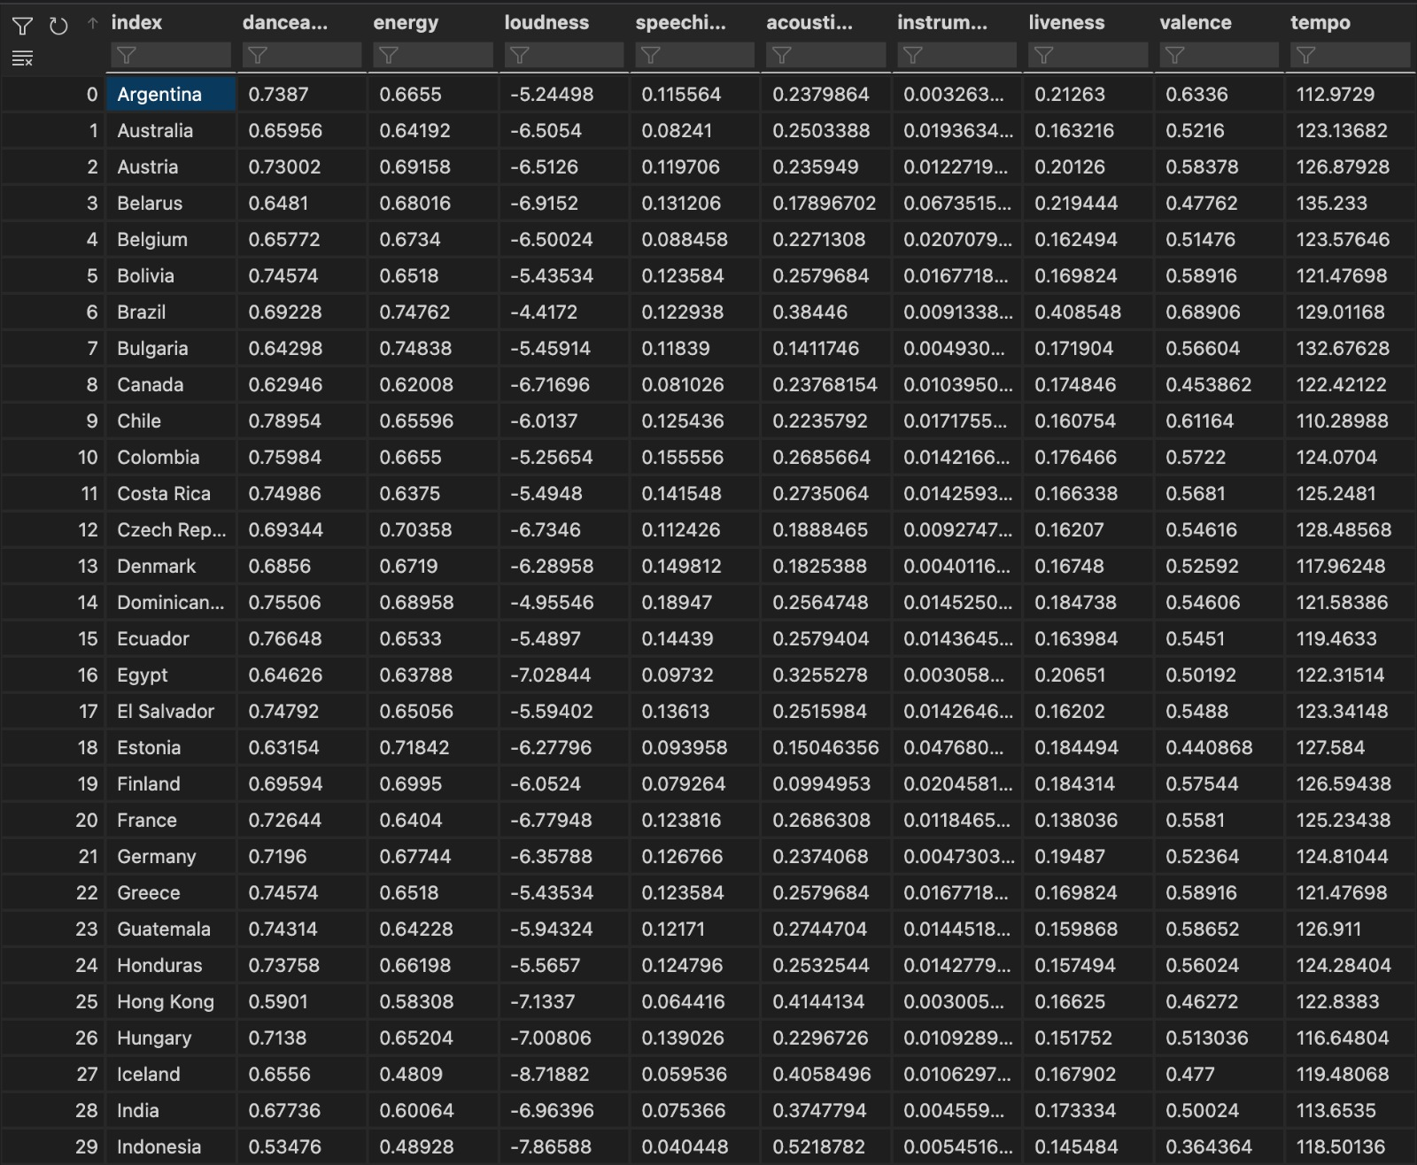

Data Processing (Dataset #2)
What is the geographic distribution of popular audio features? (Spotify API)
Contents
Our Albums
Removing irrelevant features like ‘key’ or ‘mode’
Objectives
Key Questions
Data Overview
Data Pipeline
Dataset #1
Dataset #2
Dataset #3
Notes:
Audio features of all the top 50 songs of the day in a country displayed in a dataframe

Slide 18
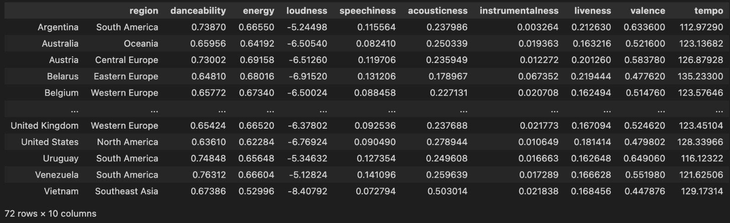
Data Processing (Dataset #2)
What is the geographic distribution of popular audio features? (Spotify API)
Contents
Our Albums
Objectives
Key Questions
Adding the region
column
Data Overview
Data Pipeline
Dataset #1
Dataset #2
Dataset #3
Notes:
Audio features of all the top 50 songs of the day in a country displayed in a dataframe

Slide 19
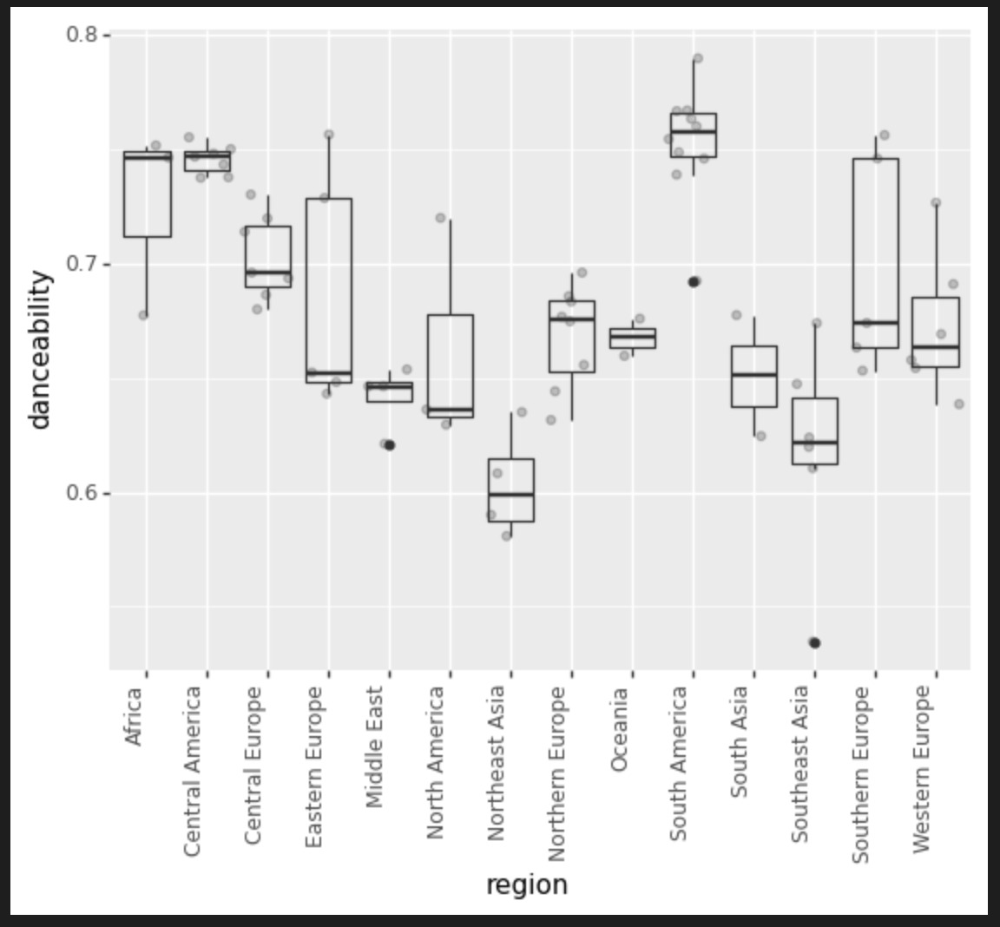
Data Visualization (Dataset #2)
What is the geographic distribution of popular audio features? (Spotify API)
Contents
Our Albums
Objectives
Making a boxplot using ggplot to plot mean danceability of a country's songs against region of the country
Key Questions
Data Overview
Data Pipeline
Dataset #1
Dataset #2
Dataset #3
Notes:
Audio features of all the top 50 songs of the day in a country displayed in a dataframe

Slide 20
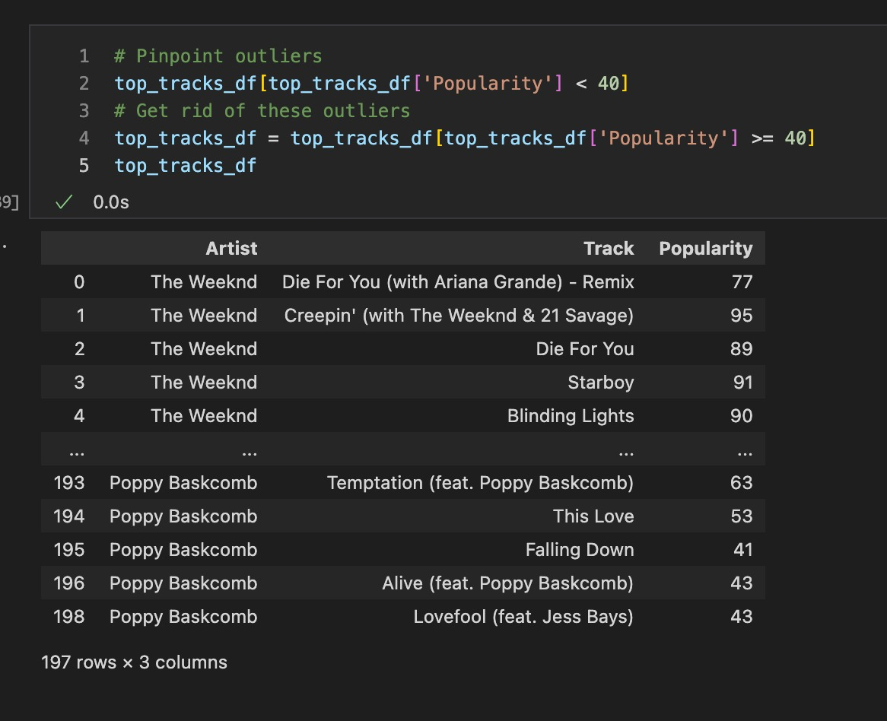

Data Processing (Dataset #3)
How do follower count, top tracks and number of streams translate to an artist’s popularity index?
Contents
Removed outliers, NaN values, and converted the Popularity Index to an integer
Our Albums
Objectives
Key Questions
Data Overview
Data Pipeline
Dataset #1
Dataset #2
Dataset #3
Notes:
Audio features of all the top 50 songs of the day in a country displayed in a dataframe

Slide 21
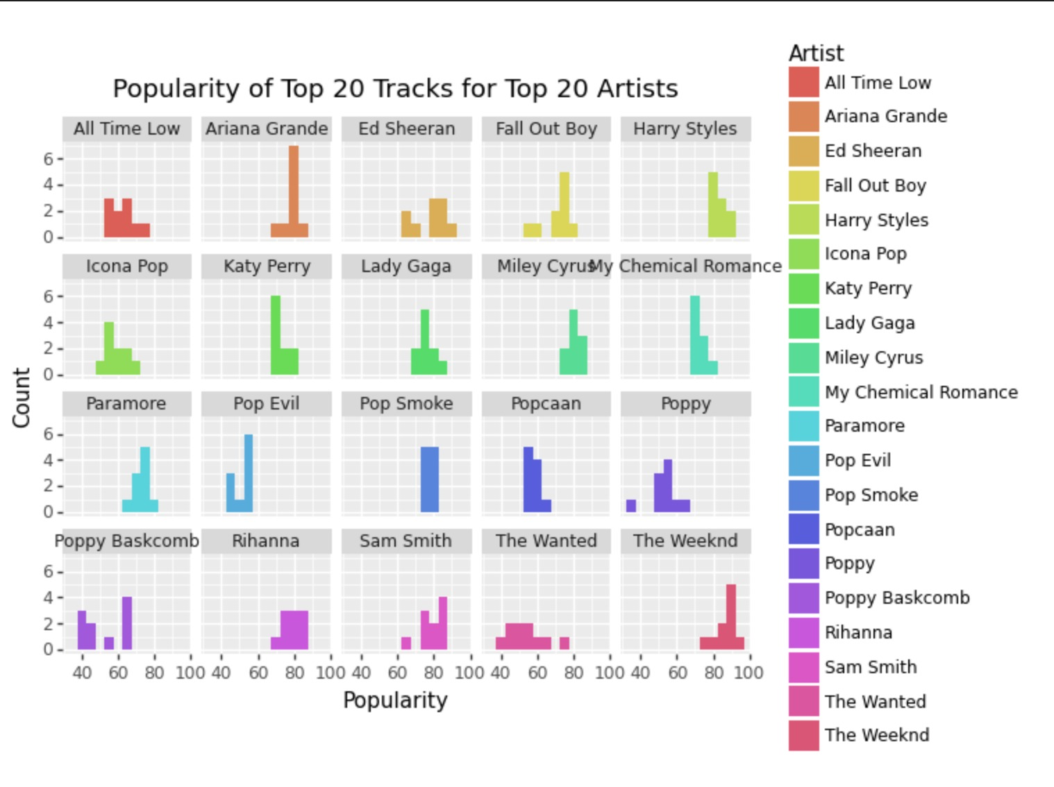
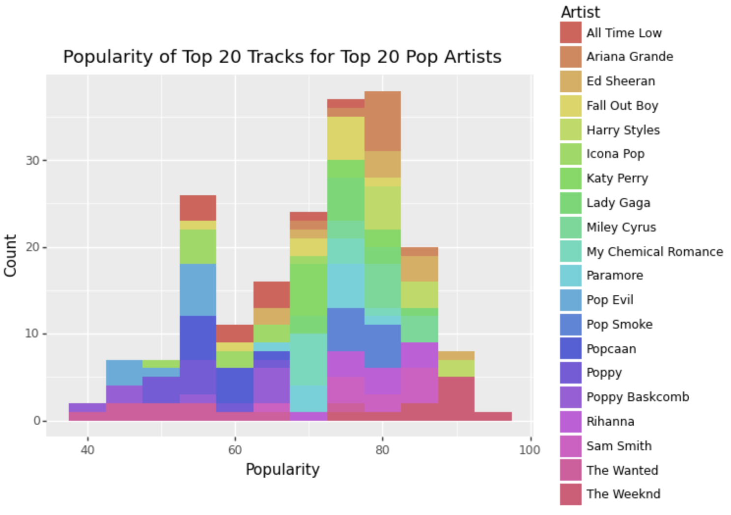
Data Visualization (Dataset #3)
How do follower count, top tracks and number of streams translate to an artist’s popularity index?
Contents
Visualising the data on popularity of top tracks
Our Albums
Objectives
Key Questions
Data Overview
Data Pipeline
Dataset #1
Dataset #2
Dataset #3
Notes:
Audio features of all the top 50 songs of the day in a country displayed in a dataframe

Slide 22
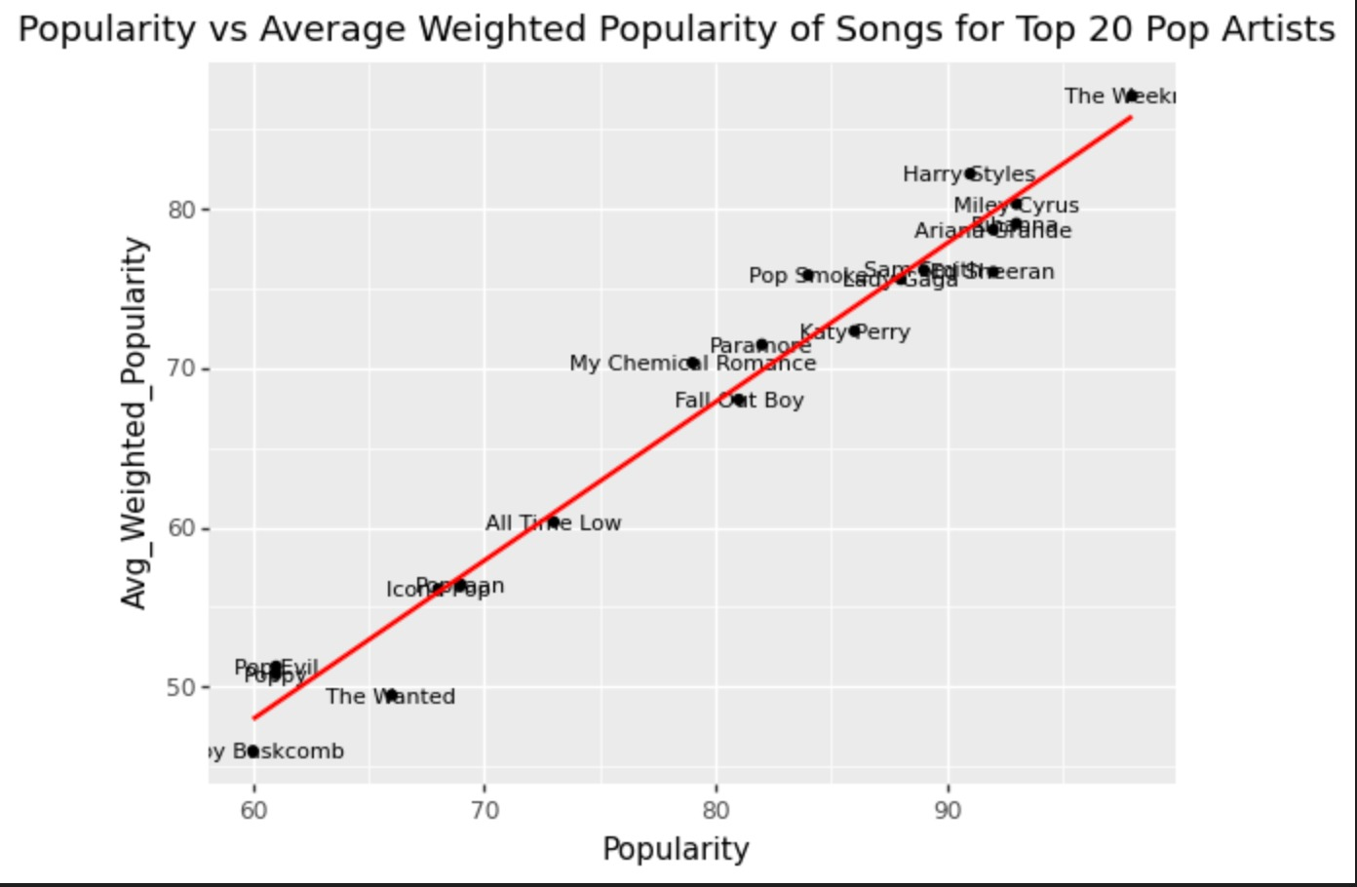
Data Visualization (Dataset #3)
How do follower count, top tracks and number of streams translate to an artist’s popularity index?
Contents
Our Albums
Objectives
Key Questions
A very strong correlation between the Top 20 song popularity scores and their respective artists popularity scores.
Data Overview
Data Pipeline
Dataset #1
Dataset #2
Dataset #3
Notes:
and this is more complex. it shows a very strong correlation between top 20 song populairty scores and their respective artists' popularity scores. That shows that usually artists who are popular have consistently have more popular songs relative to other artists

Slide 23
Challenges
Contents
Our Album
Data sampling - Choosing an appropriate sample of the data to analyse can be challenging, as different samples may yield different results
Goals
Code
Data volume and complexity – challenge in handling 2 or more APIs in drawing relevant conclusions like identifying trends, from such a vast amount of data
Data Samples
Methods
Innovation – Spotify already offers a song recommendation function and straight-forward data – more challenging to do something new and data is pretty neat so not too much pre-processing involved
Next Steps
Challenges
Research – we need to learn additional machine learning for the additional predictive model
To Be Continued…
23
Notes:
David

Slide 24

Final Project
Contents
Gather additional data and pre-process it
Put all analyses together to make it more coherent and show one main story illustrating listening trends.
Clean up the GitHub repository
Create the webpage and write the 'story'
Our Album
Goals
Code
Data Samples
Methods
Final Project – Ambitions and Goals
Next Steps
Understand historical and geographical music trends and what makes a song popular
Explore how preferences have evolved over time
Create a personalised music experience
Learn to create a tool that can be used in real-life
Challenges
To Be Continued…
Notes:
Kim
Summary of statistics: Information on the most popular artists, genres, songs

Slide 25
Thank You

